Slide 1

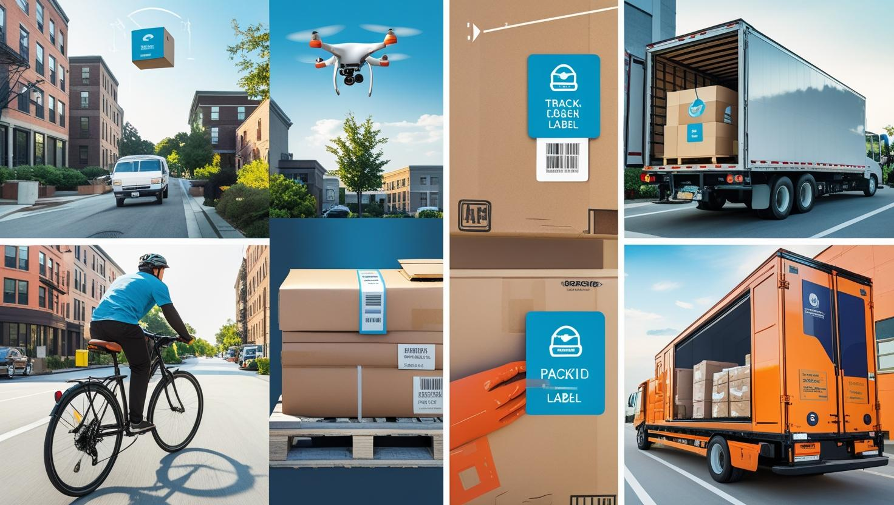

Slide 2

CROSS-BORDER FREIGHT TRADE ANALYSIS USING CRISP-DM FRAMEWORK by PENIEL TENKORAMAH TWUM

Slide 3
INTRODUCTION
The TransBorder Freight Program under the Bureau of Transportation Statistics (BTS) offers detailed data on North American freight movement between the U.S., Canada, and Mexico.
This dataset covers:
Mode of transportation
Commodity type
Geographic breakdown
The data supports:
Border and infrastructure planning
Marketing and logistics strategies
Broader transportation research

Slide 4
PROJECT OBJECTIVES
Quantify Trade Volume and Value Trends.
01
Evaluate Transportation Mode Efficiency.
02
Identify Top Trading Partners and Commodities.
03
Generate Actionable Insights for Infrastructure Planning
04

Slide 5
CRISP-DM FRAMEWORK
EVALUATION
DEPLOYMENT
Data Understanding
Modeling
Business Understanding
Data PREPARATION

Slide 6
BUSSINESS QUESTIONS
What are the transport modes and how do they compare in terms of freight charges between export and import?
How do goods values differ between Countries over the years?
Are there seasonal trends in freight movement comparing the months in a year?
What is the correlation between shipment weight and freight charges?
Which US states handle the most freight traffic across borders?
Which states/provinces in Mexico and Canada are the most active in trade?
What are the top commodities exported/imported by value and weight?

Slide 7
Exploratory Data Analysis (EDA)
Total Value:
$ 6.44 Trillion
Average Charge PER KG:
$ 0.03
DATA SHAPE
(4101624 rows, 18 columns)
TIMEFRAME
January 2020 – SEPTEMBER 2024
TOTAL FREIGHT CHARGES:
$ 84.23 Billion

Slide 8
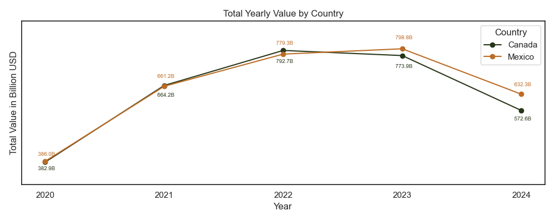
KEY INSIGHTS
While both countries followed similar trade growth patterns initially, Mexico has consistently outpaced Canada in total trade value from 2022 onward, signaling its growing role in U.S. cross-border trade.

Slide 9
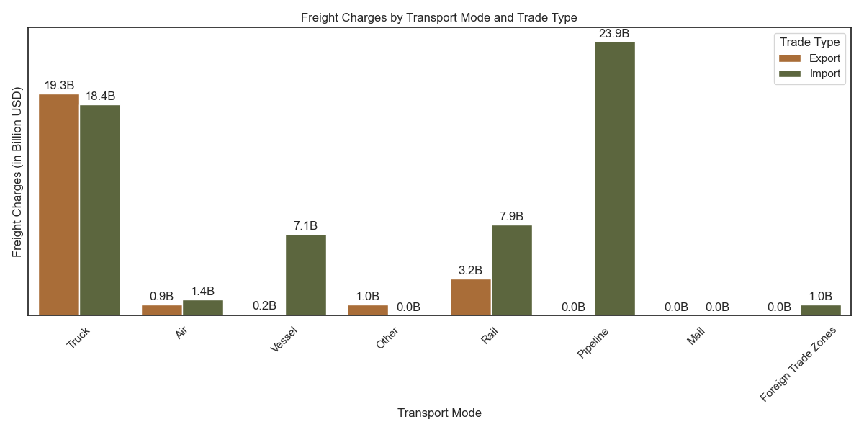
KEY INSIGHTS
Truck transport dominates both export and import freight charges, with $19.3B for exports and $18.4B for imports (indicating its critical role in cross-border trade logistics.)
Truck and pipeline are the leading transport modes by cost, with truck used across both trade types and pipeline heavily used for importing high-volume commodities. Rail and vessel are important secondary modes, mostly serving import-heavy flows.

Slide 10
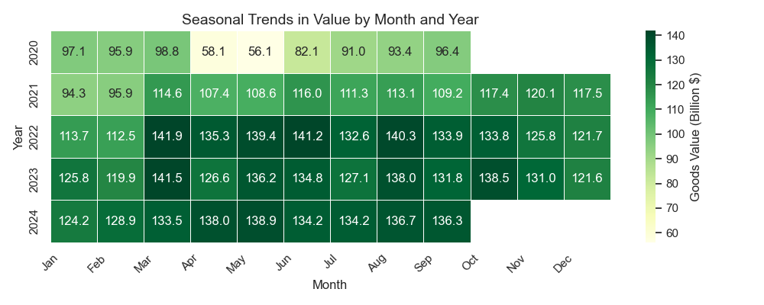
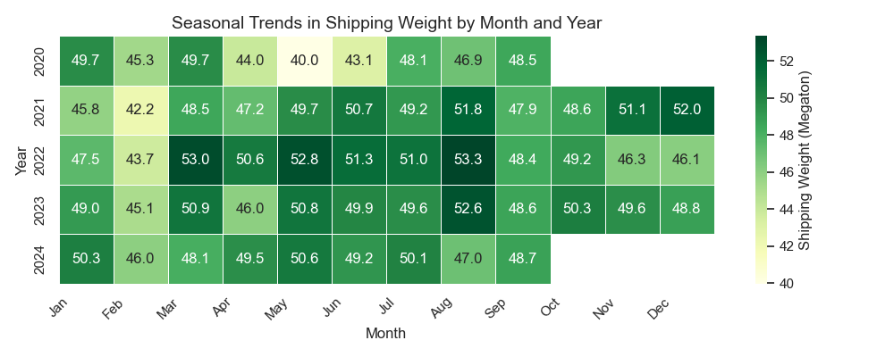
KEY INSIGHTS
Seasonal Trade Trends
The freight value tends to peak around March, mid-year (June–July), and October–November, while occasional dips in spring and post-holiday periods are evident.
Shipping weights generally increase over the years, with peak activity in the summer months (May–August) and lower volumes in winter and early spring (February–April), showing a clear seasonal pattern.

Slide 11
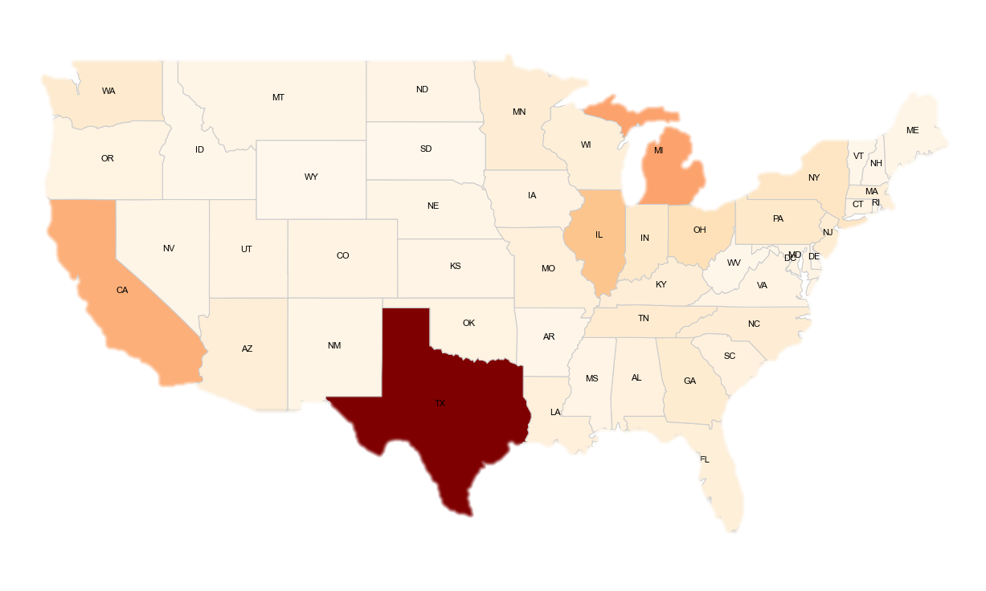
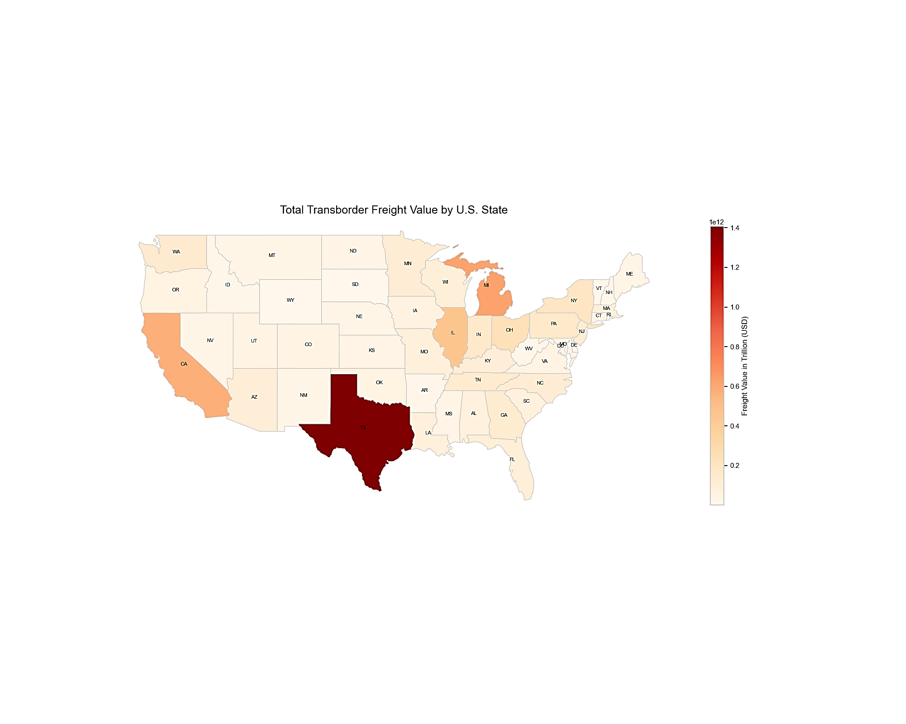
KEY INSIGHTS
USA States Trade Value Distrubution
The map shows that Texas leads all U.S. states in total transborder freight value, significantly surpassing others, followed by California, Michigan, and Illinois with moderate freight values. Most other states have relatively low transborder freight activity.

Slide 12
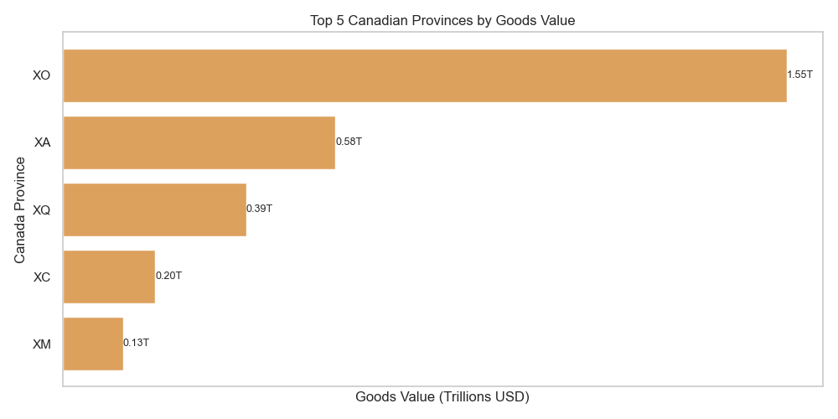
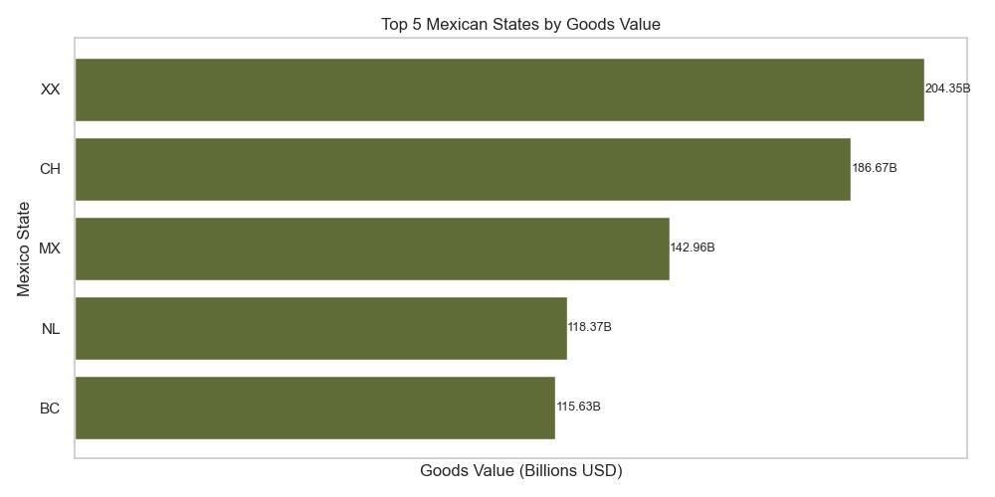
KEY INSIGHTS
Active Mexico States and Canada Province
Canada Province Ranking
XO Ontario
XA Alberta
XQ Quebec
XC British Columbia
XM Manitoba
Mexico State Ranking
XX Unknown
CH Chihuahua
MX Estado de Mexico
NL Nuevo Leon
BC Baja California

Slide 13
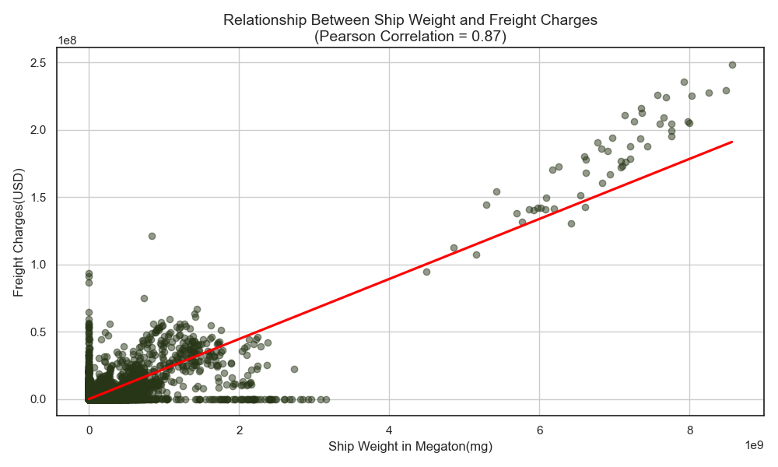
KEY INSIGHTS Freight Charges & Weight Correlation
A strong positive linear relationship between ship weight and freight charges, with a Pearson correlation of 0.87, as shipping weight increases, freight charges tend to rise proportionally. The regression line reinforces this trend, though there is some variability at lower weights.

Slide 14
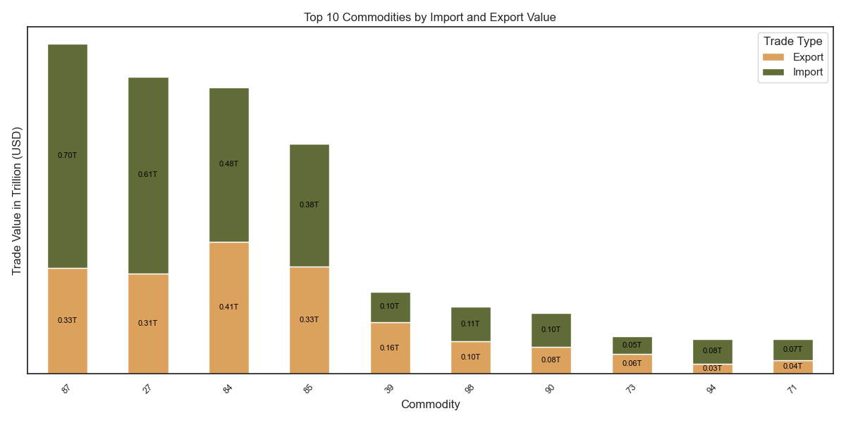
KEY INSIGHTS
Most Active Commodities
Commodity Rank Mapping
-87: "Vehicles & parts
-27: "Fuels"
-84: "Machinery and appliances
-85: Electronics
-39: Plastic products
-98: Special category
-90: Optical Instruments
-73: Iron or Steel
-94:Furniture
-71: Jewelry

Slide 15
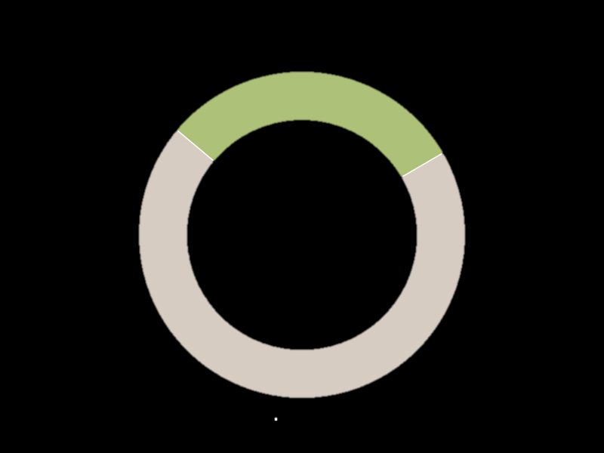
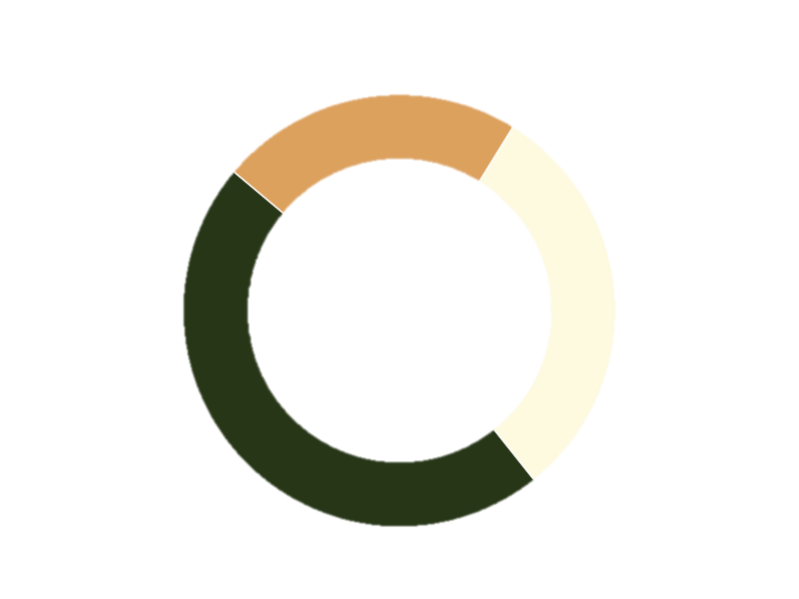
KEY INSIGHTS
Average Trade Type Distribution
Average Origin Distribution
Import (30.5%)
Foreign (22.7%)
Unknown (30.5%)
Export (69.5%)
Domestic (46.8%)
A strong export-oriented trade balance in the observed in the transborder freight movement.
While domestic sourcing is the largest category, a significant portion of items lack clear origin data, potentially affecting supply chain transparency.

Slide 16
BUSINESS RECOMMENDATIONS
Prioritize Infrastructure Development in High-Freight States
Prepare for Seasonal Freight Surges
Enhance Supply Chain Transparency
Promote Export-Friendly Trade Policies
Optimize Shipping Weight to Manage Freight Costs

Slide 17
LIMITATIONS & FUTURE WORK
Limitations
Incomplete Domestic/Foreign origin classification
Broad commodity categories limit detail
No cost breakdown in freight charges
Missing route and time-of-day data
Future Work
Integrate real-time freight or customs data
Analyze more detailed commodity classifications
Include route-level optimization insights
Build predictive forecasting models
Evaluate environmental impact by transport mode

Slide 18
CONCLUSION
The analysis revealed clear seasonal shipping trends, a steady increase in freight weight over time, and Texas as the top trade hub. A strong correlation exists between ship weight and charges, and exports dominate imports. These insights suggest the need for improved infrastructure planning, data transparency, and adaptive logistics strategies for better cross-border freight management.

Slide 19
REFERENCES
Data Source: https://www.bts.gov/topics/transborder-raw-data
Tools & Technologies
* Python (pandas, seaborn, matplotlib, scipy, geopandas)
* Jupyter Notebook
* Git & GitHub
* CRISP-DM methodology
* Excel (preprocessing)
Author
PENIEL TENKORAMAH TWUM
Geospatial Data Analyst
linkedin.com/in/peniel-t
github.com/Peniel-T
@penieltwum42@gmail.com

